Slide 1
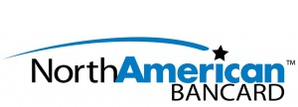
How to Determine the Best Merchant Solution for Your Business:
A 12 Part Guide
Brought to You by Choice Merchant Services

Slide 2
Table of Contents
Part 1: How Much Am I Paying Now and How Much Less Can I Be Paying if I Switch Providers?
Part 2: The Best Merchant Equipment & Software
Part 3: Do I Need Software? Merchant Equipment? How Much Will This Cost?
Part 4: Integrating Merchant Services Solutions
Part 5: Should I Accept All Cards & Options?
Part 6: What Merchant Solution Speeds Checkout & Increase Sales?
Part 7: Mobile Payment Solutions
Part 8: Secure & Fast Money Transfer from Payment Processing
Part 9: Merchant Services Data Security
Part 10: Liabilities of Accepting Electronic Payments
Part 11: Merchant Services Advances & Lines of Credit
Part 12: Electronic Gift Cards and Merchant Services
Bonus: Merchant Service Providers Can Increase Your Sales

Slide 3

The Best Merchant Solution
Part 1:
How much am I paying now and how much less can I be paying if I switch providers?

Slide 4
Let’s cover the 1st part of the question first – “How much am I paying now”?
You may be surprise by the level of difficulty there is in answering this question. Merchant service providers purposely make it difficult for you to know what your merchant services rates are so you can not compare them against a competitor. To find this answer, the first thing you want to get a look at is your current merchant services statement. Take a look at your total processing volume and see how many dollars you processed through your merchant account in that amount of time. Then find the total fees paid to your merchant account provider. After you have found both numbers divide the total fees by the total processing volume and you have found your effective merchant services rate. The next thing to find out is if you are on interchange plus pricing or if you are on 3-tier pricing. If you see a total markup of interchange pricing plus a clear mark of fee of X number of basis points you are on interchange plus pricing. If you see words such as “qualified,” “mid-qualified”, and “non-qualified,” you are on 3-tier pricing. For 3-tier pricing in order to figure out what your rates are take your total fees at each level and divide it by your total processing volume. Similarly, you will notice per-transaction fees on your statement. Divide the total cost of transaction fees by the total number of transactions and you will know your per transaction fees. Then enter all of these fees and your average monthly fees into free 3rd party-tools such as the Merchant Services Rates Calculator.

Slide 5
The next question is “How much less can I be paying if I switch providers”?
The best way to compare this is to analyze your current merchant statements. Then, request quotes from 2-3 different merchant services providers and ask what they would charge for the same fees. Then simply compare the the new vendors against your current merchant provider by looking at your expected processing volume. Again free 3rd party-tools such as the
Merchant Services Rates Calculator, can help you to know the exact savings when comparing the merchant account providers.
Typically by switching merchant providers you can save approximately 30%. This is because most merchant accounts are sold at a mark-up and over-time a merchant provider will gradually raise your rates without notification just like your bank usually drops your interest rates on your checking accounts without telling you. This is why it is important to find a merchant provider that will offer you a low rate and a promise of locking that rate in for you. In addition, some merchant account providers will offer you free merchant equipment which is another way to save money in payment processing.
Keep reading for the next chapter of our 12 part series. Our next topic is “What is the best merchant software and merchant equipment for my needs?”

Slide 6
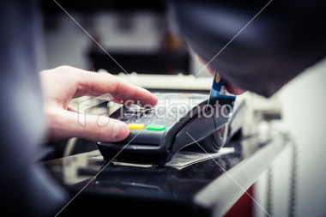
The Best Merchant Solution
Part 2:
The Best Merchant Equipment & Software

Slide 7
First, there are the basics that all merchant services solutions should have:
1. Your merchant payment solution should be PCI Compliant. If they are not you will be in violation of the latest legal requirements to accept electronic payments. In addition, by accepting payments through PCI complaint merchant equipment or merchant software your customers financial data is more secure and this lowers the instance of credit card fraud.
2. If you are doing in person-transactions you want to have a way to accept credit cards through a terminal by swiping a credit card through your merchant equipment. Why? Not only does this provide a faster buying experience for your customer – it can cut your fees to accept credit cards by about 50%. Card providers such as Visa, MasterCard, American Express and Discover charge less to process a swipe transaction because the instance of credit card fraud is much lower when someone has a card-in-hand instead of simply giving the merchant a number to key in. This savings should then get passed onto you through your merchant account provider and save your money in processing fees every time you run a transaction.

Slide 8
The next questions you need to ask are more tailored to your business:
1. Will most of my transactions be occurring through my website’s ecommerce features?
If so, you need an ecommerce merchant services solution such as Authorize.net or PlugnPay. If your website does not have a shopping card built into it then you can use the shopping cart that comes for free with Authorize.net or PlugnPay. If your website does already have a shopping card you can plug it into Authorize.net or PlugnPay Gateway. If your business offers a recurring revenue model you will probably want the recurring billing module that comes with PlugnPay. If your business has a decent amount of credit card fraud you will want the protection of Fraud Trak2 from PlugNPay. Otherwise, both of these options are good for your business.
2. Would I like to have all of my transactions run through a PC and integrated into my account system so that all financials are centralized?
If so, PCCharge may be the right solution for your business. PCCharge can handle in person transactions as well as remote phone order, or direct mail transactions.

Slide 9
3. Is it important that my merchant equipment offer the latest and greatest?
If so, then you want something like the Vivopay 4000 or Phone Swipe. The Vivopay 4000 offers traditional swipe as well as keyed in retail transactions yet it also offers tap and go technology that enables customer to tap their credit card or smart phone against the merchant equipment with a simple tap of their “mobile wallet” against the payment terminal. Similarly the Phone Swipe, offers this technology but the merchant equipment plugs directly into your iPhone, iPad, or Droid device. For any business that accepts payments in the field, such as a delivery company the Phone Swipe is the best method of accepting payment.
4. Are you a doctor’s office, restaurant, or a traditional retail store? Then you have a broad array of options. In your case you should not be paying for merchant equipment as there are providers that will give you everything you need to accept payments for free. Merchant equipment such as the First Data FD100, the Omni VX570, or the Nurit 8020 will work great for you.
If you have questions you can continue to do research but you should also be able to talk on the phone with your merchant services provider and ask them. If they will be a good partner for your business they will talk with you through the pluses and minuses of each solution for YOU and then can then advise you on the best solution for your business.
Keep on reading. Our next chapter of this 12 part merchant service series will be “Do I need software? Do I need equipment? How much will this cost?”

Slide 10
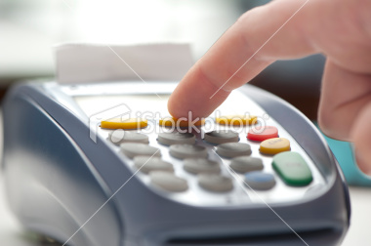
The Best Merchant Solution
Part 3:
Do I need software? Merchant equipment? How much will this cost?

Slide 11
When trying to find the best merchant solution for your business you can know that off of the bat you are either going to need merchant equipment, merchant software or both. Then question is how will you know which you need. Here’s how:
You are going to need merchant equipment if you are accepting transactions in person more than a few times per month. If you are accepting payments in person only a few times per month touch tone phone solutions such as Dial Charge will work fine. Otherwise you will need merchant equipment. If you are unsure which merchant equipment is right for your business read part 2 of our 12 part series
The Best Merchant Equipment & Software for Your Business. All merchant equipment that you get should be free as part of your merchant service processing agreement.
You are going to need merchant software if you are accepting payments via a website. You will either want Authorize.net or or PlugNPay as your gateway. This service should cost you no more than $25 per month.

Slide 12
4. The other type of merchant software you may want is PC Charge. This tool is great if you want to integrate your transactions into your accounting or computer system. PC Charge simple turns any PC into a credit card processing terminal by plugging in a card read directly into the USB port on any PC or Apple computer. You should be able to get this software for free as part of your credit card processing agreement.
Keep reading for part 4 of our 12 part series – “Integrating Merchant Payment Solutions Into Accounting Systems.” In this series we will answer the following questions: “Will this solution I am getting integrate into my accounting systems and payment systems or no? If not, do I need a new system? If so, how do I get them to integrate? Is the integration easy?”

Slide 13
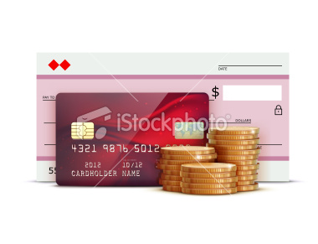
The Best Merchant Solution
Part 4:
Integrating Merchant Services Solutions

Slide 14
In this this chapter we are going to discuss the question of integrating your merchant service solution into your business and accounting systems. Common questions that a controller or business owner will ask when making a decision on a new merchant services solution are are:
Does his solution I am getting integrate into my accounting systems and payment systems or no?
2. If not, do I need a new system?
3. If so, how do I get them to integrate? Is the integration easy?
The short answer:
This is fairly complicated. If you want a good answer that is specific to your unique needs and desires talk to a merchant services provider that will take the time to ask you the right questions to find out what you want to do and then give you a solution to do it. Any company that is not great at doing this for you prior to signing up is not going to be good at it after you sign up.

Slide 15
The longer answer:
1. If you accepting payments via a website you are going to want to use Authorize.net or PlugNPay. PlugNPay offers a built in Quickbooks module where you can sync all of your transactions detail directly into Quickbooks. PlugNPay also offers a great recurring billing module that can help you automate your billing if you have a recurring-billing business model. If you are not using Quickbooks but another type of accounting system then we would recommend Authorize.net as it offers a very robust back-end that can integrate into almost any type of system.
2. If you accepting payments at a doctor’s office, company office, then we would recommend that you use PC Charge. PC Charge is one of the most versatile payment solutions and it allows easy integration into many payment systems.
3. If you would like to accept credit cards through traditional merchant equipment that would typically be used at a retail business location your best option may be some of the newest merchant equipment such as the VivoPay 4000 in that it offers easy syncing features with some of the most popular accounting systems.
Keep on reading. Next we will go into part 5 of our 12 part merchant services series and talk about questions such as: What forms of payment should I take and can I take? Can I accept Visa, Mastercard, American Express, Gift Cards, Promo Codes on my website, Debit Card, or eCheck?

Slide 16
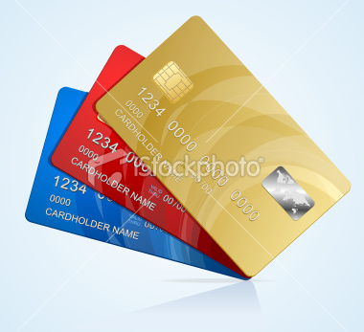
The Best Merchant Solution
Part 5:
Should I Accept All Cards & Options?

Slide 17
In this chapter of our services we will discuss the following question: Can I accept Visa, Mastercard, American Express, Discover, Gift Cards, Promo Codes on my website, Debit Card, or eCheck?
The short answer: Yes any high quality merchant service provider should be able to offer you everything mentioned above.
The next question is: should you accept Visa, Mastercard, American Express, Discover Gift Cards, Promo codes on my website, Debit Cards or eCheck?
The short answer: It depends. Let’s break this question out in parts.
Visa, Mastercard, American Express, Discover
First off, any business should accept all major credit cards. That includes Visa, Mastercard, American Express & Discover. If you don’t you will lose sales revenue.

Slide 18
Debit Card & eCheck
If your business is a doctor’s office, business to business company, or retail outlet you should also accept Debit Card and eCheck. You should do all of the above because it increases your sales. Some companies may opt to accept checks but will not electronically verify them. This is a mistake. Electronically verifying the checks made out to you at the point of purchase will let you know if the check you are accepting is good. It will save your company a lot of lost revenue and lost time in collections.
Promo Codes on a Website
If your business offers ecommerce transactions online, make sure you have the ability to offer promo codes on your website. These promo codes can be used in your online advertising, word of mouth advertising, advertising on online coupon sites, as well as television and radio advertisements. Promo codes not only increase your sales but they help you track the return on investment from all of your different advertising offerings.

Slide 19
Gift Cards
The last question is gift cards. All retail companies and restaurants should offer gift cards. The advantage of doing it through a merchant service processor is that you can see the balance of all of your unused gift card amount and you can make sure that no one takes advantage of the system as is often the case with paper gift cards.
In the next chapter we will discuss the question of: “What solution can give my customers the easiest shopping experience? How can your solution help me increase my sales by upsell, cross-sell?”

Slide 20
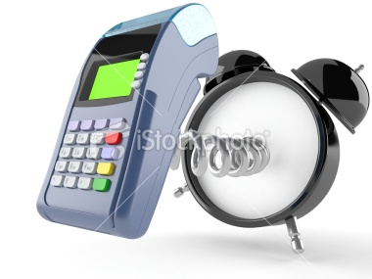
The Best Merchant Solution
Part 6:
What Merchant Solution Speeds Checkout & Increases Sales?

Slide 21
In this chapter of our services we will discuss the following question: “What solution can give my customers the easiest shopping experience? How can your solution help me increase my sales by upsell, cross-sell?”
Retail, Restaurant or Doctor’s Office Merchants If you are accepting credit cards in person at a retail store, restaurant, or at an office location such as a doctor’s office you should use the Vivopay 4000. The Vivopay 4000 allows you to accept payments incredibly fast. If offers fast broadband connection as well as tap and go technology for those who have Mobile Wallet equipt smart phones. This fast check out time can improve your sales as customers today are busy. If they can get what they want fast and then get going they are more likely to come back to your business again. In addition, the Vivopay 4000 also empowers you to accept gift cards. As we stated in previous posts:
All retail companies and restaurants should offer gift cards. The advantage of doing it through a merchant service processor is that you can see the balance of all of your unused gift card amount and you can make sure that no one takes advantage of the system as is often the case with paper gift cards.

Slide 22
In addition, the Vivopay 4000 also empowers you to accept gift cards. As we stated in previous posts:
All retail companies and restaurants should offer gift cards. The advantage of doing it through a merchant service processor is that you can see the balance of all of your unused gift card amount and you can make sure that no one takes advantage of the system as is often the case with paper gift cards.
In addition, gift cards offer the added bonus of improving sales through word of mouth advertising, as well as unused products and services that are purchased on the gift cards and never redeemed.
Home Improvement & Mobile Merchants If you want to accept payments anywhere your best solution is Phone Swipe. Phone Swipe is the lowest cost mobile payment solution on the market. It allows you to simply plug a free phone adapter into your smart phone and then accept credit cards anywhere in the world that your mobile carrier is connected. This allows your customers to quickly pay out on the spot as you pull out your small smart phone and swipe their credit card through the several inch reader that you plug into it.

Slide 23
There is another benefit to Phone Swipe. When you use it, you will save a lot of money in credit card processing costs. That is because instead of a 4% of transaction fee to accept a payment via a keyed in transaction, you will pay just 2.69% per swiped transaction. Imagine getting to keep 1.31% of your total company revenue as profit. That is what Phone Swipe does for you.
eCommerce Merchants
Your most robust and highest ROI way to take payments online is through Authorize.net. Authorize.net allows easy shopping cart plug-in and is also comes with free shopping cards you can put into your website. You can setup promo codes, virtual gift cards, gift cards, automatic billing, and a host of other features that will increase your sales and your return customers.
Keep on reading. Our next chapter of this 12 part merchant service series will be “What mobile payment solutions should I take? Do I need a mobile payment solution?”

Slide 24

The Best Merchant Solution
Part 7:
Mobile Payment Solutions

Slide 25
In this chapter of our services we will discuss the following questions: “What mobile payment solutions should I take? Do I need a mobile payment solution?”
What is a mobile payment solution? A mobile payment solution give you the ability to accept credit cards no matter where you are so as long as you can obtain a cellular signal. Mobile payment solutions are most often used by companies that accept credit cards in the field or in non-traditional store locations. Yet, they are also used by companies like Apple inside the Apple store because of the coolness and efficiency of these type of payment solutions. Do I need a mobile payment solution? If you are accepting payments in-person, yet out in the field then you must obtain a mobile payment solution. Examples of companies that should accept credit cards in the field are pizza delivery, plumbers, window replacement, home improvement, landscapers, taxi-drivers, farmer’s market stands. Yet, Unless your business is a doctor’s office or a retail location where 100% of our customers come to you in a traditional location it is a good idea to have a mobile payment solution. This is because if you can accept credit cards in person with the plastic card being swiped through a terminal you can save as much as 40% in credit card processing fess. Swiped transactions cost less to run per transaction than manually keyed in transactions.

Slide 26
This is because there is less risk of credit card fraud for a card in hand transaction and there is also a lower risk of an unsatisfied customer who wants to run a charge back. The net result is that card issuing companies like Visa, MasterCard, American Express and Discover charge less to run a transaction that is swiped through a terminal and companies like Choice Merchant Services then pass that savings onto you.
What mobile payment solution should I use? We recommend Phone Swipe. To take some excerpts from previous posts we made about Phone Swipe:
If you want to accept payments anywhere your best solution is Phone Swipe. Phone Swipe is the lowest cost mobile payment solution on the market. It allows you to simply plug a free phone adapter into your smart phone and then accept credit cards anywhere in the world that your mobile carrier is connected. This allows your customers to quickly pay out on the spot as you pull out your small smart phone and swipe their credit card through the several inch reader that you plug into it.
There is another benefit to Phone Swipe. When you use it, you will save a lot of money in credit card processing costs. That is because instead of a 4% of transaction fee to accept a payment via a keyed in transaction, you will pay just 2.69% per swiped transaction. Imagine getting to keep 1.31% of your total company revenue as profit. That is what Phone Swipe does for you.

Slide 27
Competitors of Phone Swipe such as Square charge more money and they offer less robust customer-service. There are also other mobile payment solutions you could get such as the
Verifone VX670 and Way Systems yet they are big and bulky by today’s standards. You can also use Dial Pay to accept credit cards from any cell phone by keying in the credit card information – yet this system will raise your credit card processing costs by as much as 40% since all transactions that it would process are keyed in as opposed to swipe transactions.
Keep on reading. Our next chapter of this 12 part merchant service series will be part 8, “How secure is my customers’ data, including their credit card information? Is the solution you are providing me PCI complaint?”
one Swipe. To take some excerpts from previous posts we made about Phone Swipe:
If you want to accept payments anywhere your best solution is Phone Swipe. Phone Swipe is the lowest cost mobile payment solution on the market. It allows you to simply plug a free phone adapter into your smart phone and then accept credit cards anywhere in the world that your mobile carrier is connected. This allows your customers to quickly pay out on the spot as you pull out your small smart phone and swipe their credit card through the several inch reader that you plug into it.

Slide 28
There is another benefit to Phone Swipe. When you use it, you will save a lot of money in credit card processing costs. That is because instead of a 4% of transaction fee to accept a payment via a keyed in transaction, you will pay just 2.69% per swiped transaction. Imagine getting to keep 1.31% of your total company revenue as profit. That is what Phone Swipe does for you.
Competitors of Phone Swipe such as Square charge more money and they offer less robust customer-service. There are also other mobile payment solutions you could get such as the Verifone VX670 and Way Systems yet they are big and bulky by today’s standards. You can also use Dial Pay to accept credit cards from any cell phone by keying in the credit card information – yet this system will raise your credit card processing costs by as much as 40% since all transactions that it would process are keyed in as opposed to swipe transactions.
Keep on reading. Our next chapter of this 12 part merchant service series will be part 8, “How secure is my customers’ data, including their credit card information? Is the solution you are providing me PCI complaint?”

Slide 29

The Best Merchant Solution
Part 8:
Secure & Fast Money Transfer from Payment Processing

Slide 30
In this chapter we will discuss the following questions: “How secure is my money? How long after a payment is made until the funds are in our business checking account?”
When running merchant services processing for your business there are two very real concerns that many businesses have. Simply put companies want their money made securely and fast. This should be standard in today’s world of fast processing.
Security In short as long-as your merchant service provider is PCI compliant you should be safe in getting your payments quickly made to your bank account. By law, all merchant services processors must be PCI compliant. You want a provider that is Level 1, PCI Complaint which is the highest level of PCI compliance. Level 1 PCI Compliance means that your provider has been audited by an outside firm and that they to meet or exceed standards for using PCI complaint merchant software, merchant equipment, data storage of credit card and billing data, employee background checks, processes for updating programs and more. If your provider is Level 1 PCI complaint then all transactions are made, all money is moved, and all data is stored using the most advanced encryption and firewalls that are used for financial protection.

Slide 31
Fast Deposits Your merchant account provider should be able to ensure all deposits are made within 24 hours of a transaction being completed. It could be done faster if you would like, yet there are extra fees associated with faster movement of your money. What essentially happens is that upon signup for your merchant account you let your merchant services provider know what account you would like your merchant account deposits made into and fees taken out of. Then daily your company will run all transactions. Daily, at the time of your choosing all of the transactions from the past day will then be batched and placed into your business checking account. Most providers usually charge a batch header free of $0.05 to $0.10 for this service, so if you would like to do it more often your monthly fees will go up.
Keep on reading. Our next chapter of this 12 part merchant service series will be part 9, “How secure is my customers data, including their credit card information? Is the solution you are providing me PCI complaint?”

Slide 32

The Best Merchant Solution
Part 9:
Merchant Services Data Security

Slide 33
Welcome to part 9 of our 12 part series –
“Tell Me the Best Merchant Solution for My Business.” In this chapter of our series we will discuss the following questions: “How secure is my customers data, including their credit card information? Is the solution you are providing me PCI complaint?”
PCI Compliance It is a must. Demand that your merchant services provideris PCI compliant. They should be Level 1 PCI complaint which means that your customer’s precious payment information is as secure as it gets. You do not want to be held liable for identify theft. Your best protection is to have Level 1 PCI compliance. Not sure if your provider is Level 1 PCI complaint? Just ask them. Want to know more about PCI Compliance? Read more at www.pcisecuritystandards.org
Data Security The bottom line is that if you are PCI complaint your customer’s data is secure. Yet, here is some additional information that can help make your customers feel more at ease and help you improve your sales with data security.

Slide 34
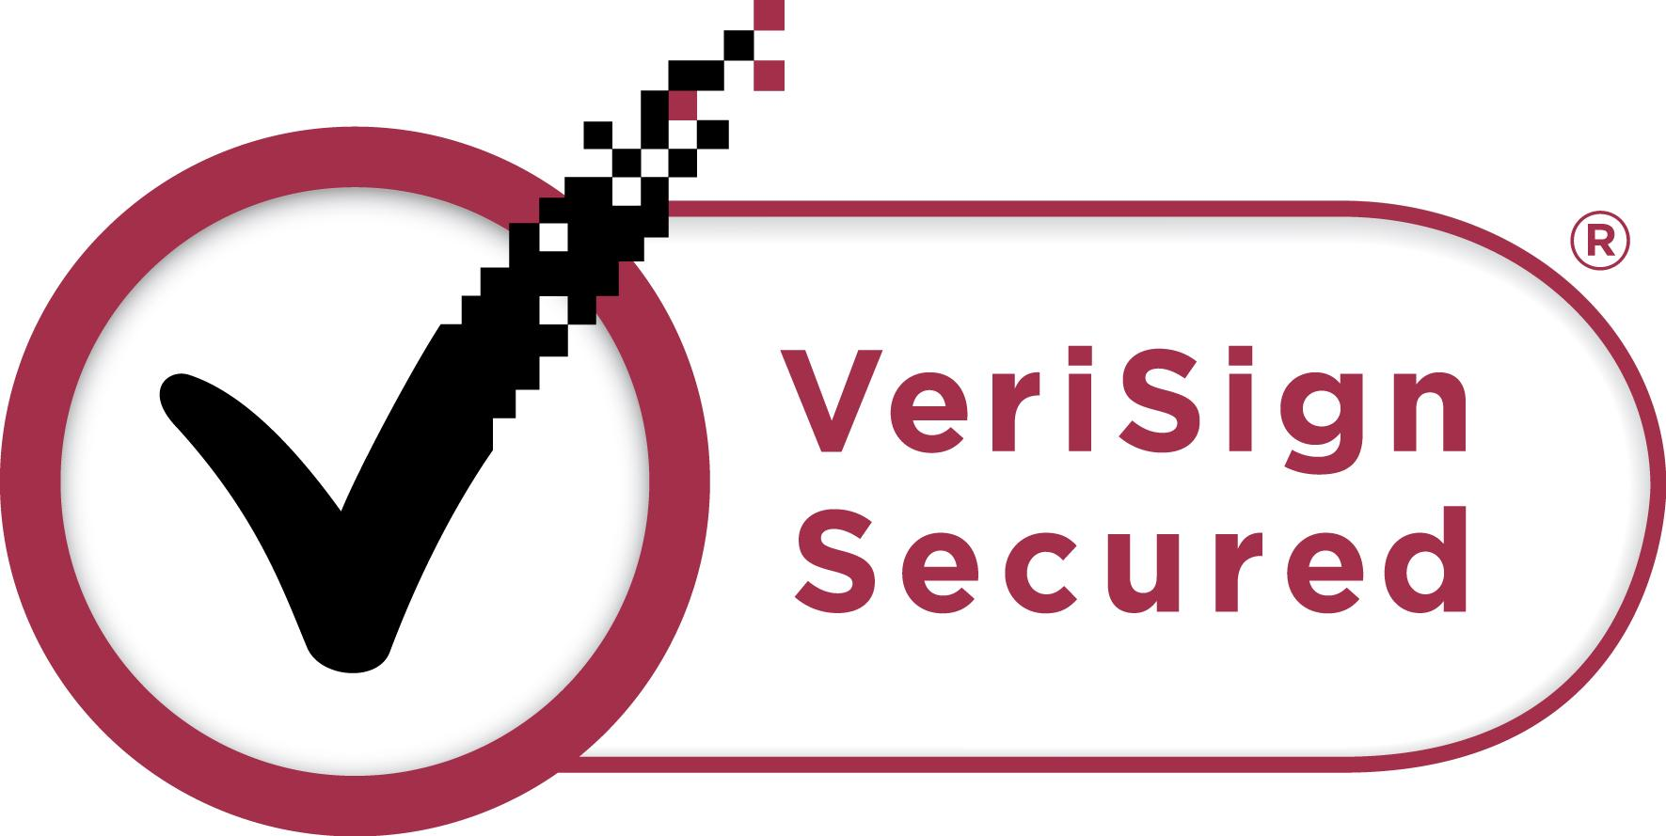
eCommerce Merchant Services
eCommerce merchants that accept payment information online are often the targets of financial attack and identity theft. This is understood by many consumers who are still a touch on the leary side to enter their payment information online. The best way for you to overcome this is to put a certified SSL certificate on ALL pages of your website where personal information is asked for. Then make sure your website is coded properly and all data that comes into that site comes from an https URL. This will prevent any security warnings from popping up on your customer’s browser, phone, or tablet. Gateways to accept payment such as PlugNPay andAuthorize.net are great solutions to your online payment needs and the offer the highest levels of customer security. In addition, adding a 3rd party security logo to all pages of our website such as a Verisign Secured logo will give you added credibility of your security and increase your sales.
In-Person Merchant Services The risk of data security threats for customer’s payment information here is not as strong as for eCommerce merchants – yet the threat from hackers is still real. Simply make sure you are using a level 1 complaint PCI complaint merchant services provider and PCI compliant merchant equipment.

Slide 35
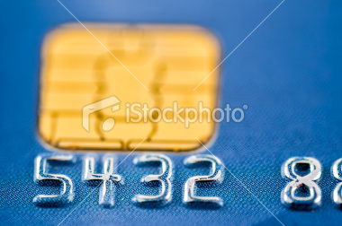
The Best Merchant Solution
Part 10:
Liabilities of Accepting Electronic Payments

Slide 36
In this chapter of our series we will discuss the following questions: “What liabilities am I accepting by accepting electronic payments? What liabilities am I protected from by doing business with you?”
By being a merchant who accepts payments online you do have some liabilities. Let’s break down the most common liabilities that you obtain by getting the dramatically improved sales that come with accepting electronic payments.
1. Stolen Credit Card Data/Identify Theft Your clients are placing their trust in you when they give you their payment information. Not only are they trusting you to deliver what you are selling to them as you have promised, they are also trusting you to protect them from identity theft. If you are using a good merchant services provider that offers strong encryption and only uses PCI complaint equipment and software you really have just about nothing to worry about so as long as you are following best practices. For example, all credit card data should be stored securely behind encrypted and password protected digital firewalls. You should NEVER write credit card information down and save a paper copy of it in your office, save it in your email, or save the information in a file such as an Excel file on your PC. If you do so, your customers data could easily get stolen by a crook and the net result may be 1K, 5K or 30K in identity theft that happened because of your insecure actions. If that could get traced back to you the identity theft victim could hold you responsible. So follow-best practices and use common sense. If you do that – all should be good.

Slide 37
2. PCI Compliance Violations If you follow these three simple rules would should be safe from almost all PCI complaint violations:
a.Do not accept payments through old and outdated merchant equipment – in other words only use approved merchant equipment. b. Only use the highest forms of encryption when accepting payments online – in other words only accept payments through Authorize.net or PlugNPay. c. Store all data securely. In other words do not store credit card data in any place but within your merchant equipment or software.
3. Chargebacks A chargeback occurs when someone makes a purchase from you and then wants a refund because they are not happy with the product or service you offered, or they claim they did not make the purchase. You are liable in both of these cases. Visa, MasterCard, American Express & Discover rules favor the end credit card user – in other words, they favor the customer. If a customer of yours reaches out to their credit card company and requests a charge back, the money is immediately debited from your checking account. The burden of proof is then on you to prove that you fully and legally deserve and are obligated to the payment. If you win the charge back – you get the money placed back in your checking account. If you lose, the money is gone forever.
How do you mitigate your risk of charge back?

Slide 38
Lets cover each type of charge back separately:
a. Cardback Due to an Unhappy Client Your best way to make sure this does not happen is offer a great product or service and do what you say you are going to do – really well. Then, have a reasonable refund policy for those that would may want a refund. You can also print your refund policy on all receipts or your customers to see and keep a record of that. Lastly, if you are accepting payments via contract or online have a terms of service written up that sells your products or services “as is” and you will be in a position to win most chargebacks.

Slide 39
b. Cardback Due to Fraud This happens when someone claims they never authorized the purchase. In this case, the burden of proof is on you to prove that the person that made the purchase was actually the person who owns the credit cards. The common advice in a situation like this to have almost no liability is to get a photo ID of every person at the point of check out and make sure the name on the ID, the picture of the person, and the name on the credit card all match. If not, do not accept the payment. Yet in reality, this upsets your customers because you are telling them you you don’t trust them. The best way to get around this for retail locations is to simply require that all of your purchases be run through the swipe or the tap and go method and that the person making a purchase enters their zip code registered to the credit card at the point of sale. If that is done – your instance of credit card fraud will be really low. For business to business, ecommerce, phone order or mail order merchants the best way to protect yourself is to get a photocopy of the credit card on file, a photo ID, and a signed contract. Yet, in reality this is not practical in most situations. Your next best option is to to get a really strong anti-fraud system such as PlugNPay’s that will cross reference billing address, credit card number, name on the credit card, and zip code and make sure they all match before allowing a credit card transaction to be accepted. You can even go so far as use the automated features ofFraudTrack2 to look at IP address and email address of the customer making a purchase.
Keep on reading. Our next chapter of this 12 part merchant service series will be part 11, “Can I take a line of credit out on my merchant payments? What is my interest rate? What is the approval process look like?”

Slide 40

The Best Merchant Solution
Part 11:
Merchant Services Advances & Lines of Credit

Slide 41
In this chapter of our series we will discuss the following questions: “Can I take a line of credit out on my merchant payments? What does it cost? What does the approval process look like?”
Can I take a line of credit out on my merchant payments? What does it cost?
Yes. Sort of. Merchant Services advances like Choice Merchant Services Capital for Merchants Program, is not a line of credit yet it operates like one. Here is how it works:
You essentially can received an advances of 1 month of merchant services processing volume.
2. The payback period is typically 4 to 8 months.
3. Most merchants pay back about $1.35 on the dollar over a 6 month period.

Slide 42
What does the approval process look like?
If your business has been in business at least 1 year and has 6 months of processing history you can be fully funded within 3 days of starting to process through Choice Merchant Services partner North American Bancard. In other words, you get approved and funded within 3 days! Compare the fast turn around here to a bank when it takes 60 to 90 days to qualify for a line of credit. The Capital for Merchants program can come in very handy when trying to make payroll, order inventory, buy a business, purchase a property, etc.
Keep on reading. Our next chapter of this 12 part merchant service serieswill be part 12, “Keep on reading. Our next chapter of this 12 part merchant service series will be part 11, “Can I accept electronic gift cards? If so, why should I? What do I have to gain and lose by doing so?”

Slide 43
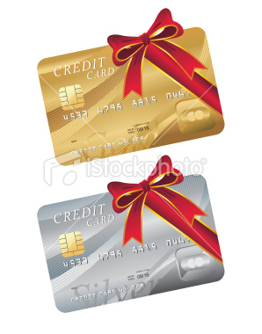
The Best Merchant Solution
Part 12:
Electronic Gift Cards and Merchant Services

Slide 44
In this chapter of our series we will discuss the following questions: “Can I accept electronic gift cards? If so, why should I? What do I have to gain and lose by doing so?”
The first question you should ask yourself is should I accept electronic gift cards. The answer is that every retailer, restaurant, and ecommerce store should accept electronic gift cards. If you do not you are missing out on large profits. The next question is if you are not a retail, ecommerce, or restaurant merchant, should you accept electronic gift cards. Ask yourself this question, “is my product or service the type of product or service that people would like to receive as a gift?” If you answer affirmative to that question, then accepting electronic gift cards is good for your business.
The second question is why will accepting electronic gift cards help your business? The fact is that accepting electronic gift cards will boost your sales because it will create word of mouth advertising for your business, and it will drive more customers to your store who will buy more than what is on the gift cards. In addition, some gift cards will simply not be redeemed therefore you will have near 100% profit on all unredeemed gift cards.

Slide 45
The key is to take your gift card program and electronically integrate it with your merchant services processing company so that all money flows into your bank account daily, all customers know their exact balance on their gift card and you can eliminate your risk of gift card fraud.
Keep on reading. Although we have finished our 12 part merchant service series, we will have a bonus chapter on the topic of “Can my payment processor actually help me increase my sales?”

Slide 46

The Best Merchant Solution
Bonus:
Merchant Service Providers Can Increase Your Sales

Slide 47
In this chapter of our series we will discuss the following questions: “Can my payment processor actually help me increase my sales?”
The answer to this question is a resounding yes. Any credit merchant service provider that is good at what they do can help you do this.
Here are 7 ways that you merchant services provider can help you improve your sales.
1. Custom In Store Receipts – Based on what your customers buy from you or have bought from you they should get custom receipts printed up for them upon purchase by your merchant equipment. Your merchant services provider should be able to give you merchant equipment and software that is capable of this. This can bring them back to your customers to your store sooner and have them buy more.
2. Electronic Gift Cards - Gift cards improve your sales because they drive people to your store to buy the gift cards. They drive new customers to your store after they receive a gift card and they can fall in love with it and come back again. They drive customers that love your store back that otherwise would not come to your store. They drive people to your store that spend all of the money on the gift card and then more. In addition, not all gift cards are redeemed meaning that you make nearly 100% profit on unredeemed gift cards. Any good merchant services provider should offer this program to you and make it easy for you to set up and maintain.

Slide 48
3 & 4. Electronic Referral & Loyalty Programs - Your merchant account should come with the ability to reward customers that refer you and that come back with special discounts and promotions. This is simple to set up and very powerful for your business.
5. Promotion Codes for eCommerce – People will be driven to your website when they get email alerts telling them of a 20% off sale if they enter promo code “BigSale20.” You can easily set this up if you partner with a merchant service provider that can offer you a good internet gateway and shopping card solution such as Authorize.net or PlugNPay.
6. Shopping Cart Abandonment Emails – If you send customers a triggered email after they add a product or service to an internet shopping cart and then fail to make a purchase, you will regain 30% to 40% of those purchases. If you do not have a merchant account provider that is capable of giving you this solution you are missing out on a lot of business.
7. Upsell Website Emails - Have you ever purchased something on-line on Amazon.com and were then told by the website, “People who liked what you are about to buy also liked X, Y, and Z.” Amazon does this because it is a great way to increase average order size and improve your customer shopping experience. Your website should do the same.

